Slide 1

Red wine Quality ANALYSIS
Team Members:
Kruti Shah (306650284)
Ravi Amin (306598765)
Riddhiben Patel (306612701)
Rutviben Patel (306019563)
Smitkumar Kaushikkumar Patel (306587208)

Slide 2
DATA SET
wineQualityReds.csv
Data set link : https://www.kaggle.com/uciml/red-wine-quality-cortez-et-al-2009

Slide 3
Project Description
It shows relation between quality and other variables of wine. We want to do transformation to see if we can increase correlation coefficient between them. Used stepwise variable selection method to choose best predictor of wine quality.

Slide 4
Goal
Our focus is to see how each chemical component influences the quality of wine (0 'very bad' to 10 'very excellent'). The usage of this analysis will help to understand whether by modifying the variables, it is possible to increase the quality of the wine on the market.

Slide 5
About the Dataset
In this project we do Analysis of Red Wine Data which contains 1,599 red wines with 12 variables on the chemical properties of the wine.

Slide 6
Input Variables
Fixed acidity: most acids involved with wine or fixed or nonvolatile (do not evaporate readily)
Volatile acidity: the amount of acetic acid in wine, which at too high of levels can lead to an unpleasant, vinegar taste
Citric acid: found in small quantities, citric acid can add 'freshness' and flavor to wines
Residual sugar: the amount of sugar remaining after fermentation stops, it's rare to find wines with less than 1 gram/liter and wines with greater than 45 grams/liter are considered sweet

Slide 7
Input Variables (cont.)
Chlorides: the amount of salt in the wine
Free sulfur dioxide: the free form of SO2 exists in equilibrium between molecular SO2 (as a dissolved gas) and bisulfite ion; - it prevents microbial growth and the oxidation of wine
Total sulfur dioxide: amount of free and bound forms of S02; in low concentrations, SO2 is mostly undetectable in wine, but at - free SO2 concentrations over 50 ppm, SO2 becomes evident in the nose and taste of wine
Density: the density of water is close to that of water depending on the percent alcohol and sugar content

Slide 8
Input Variables (cont.)
pH: describes how acidic or basic a wine is on a scale from 0 (very acidic) to 14 (very basic); most wines are between 3-4 on the pH scale
Sulphates: a wine additive which can contribute to sulfur dioxide gas (S02) levels, wich acts as an antimicrobial and antioxidant
Alcohol: the percent alcohol content of the wine
Output variable:
Quality (score between 0 and 10)

Slide 9
What I found from the Analysis of this dataset?
For the whole data set most of the people gave rating 5 and 6.
Nobody gave rating 0, 1, 2, 9, 10. This might be because most of the people randomly choose the rating 5 and 6 And surprisingly no body rated 9 and 10 means the wine quality might not be good in reality.
I first thought that acidity has predictive capability As quality increases with increase value of citric acid and decreases with increased value of volatile acidity.
For residual sugar nobody gave rating 3 and 8 for the value greater than 6.8.
May be only one people gave rating 4 for residual sugar value greater than 6.8.

Slide 10
What I found from the Analysis of this dataset?(cont.)
Most of the rating 5 falls below the alcohol value 11.
Most of the rating 7 lies above the alcohol value 11.
Rating 4, 6 are randomly distributed.
The interesting fact is for the total sulfur dioxide value from 99 to 153 people gave rating 5 except of some outliers.
People gave high rating for low value of pH.
No people rated 8 for having chloride value greater than 0.121.
For sulphate value greater than 0.94 people did not give rating 3.
May be only one people gave rating 8. Most of the people gave rating 4.

Slide 11
What I found from the Analysis of this dataset?
Density showed predictor for quality as it has trend. For higher value of density, quality is low and for lower value of density, quality is high.
The linear model gave me seven final variables (volatile acidity, log10(chlorides), free sulfur dioxide, total sulfur dioxide, pH, log10(sulphates), alcohol) for prediction of quality of wine.
There might be other variables (which are not present in our data) we need to consider for wine quality prediction.

Slide 12
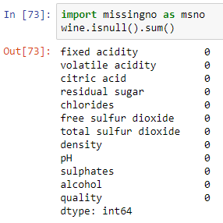
Checking the null/missing value in the Dataset [Cleaning Dataset]
This function count the colums which contain null value but here Data is pre processed and cleaned with dummy and null values.

Slide 13
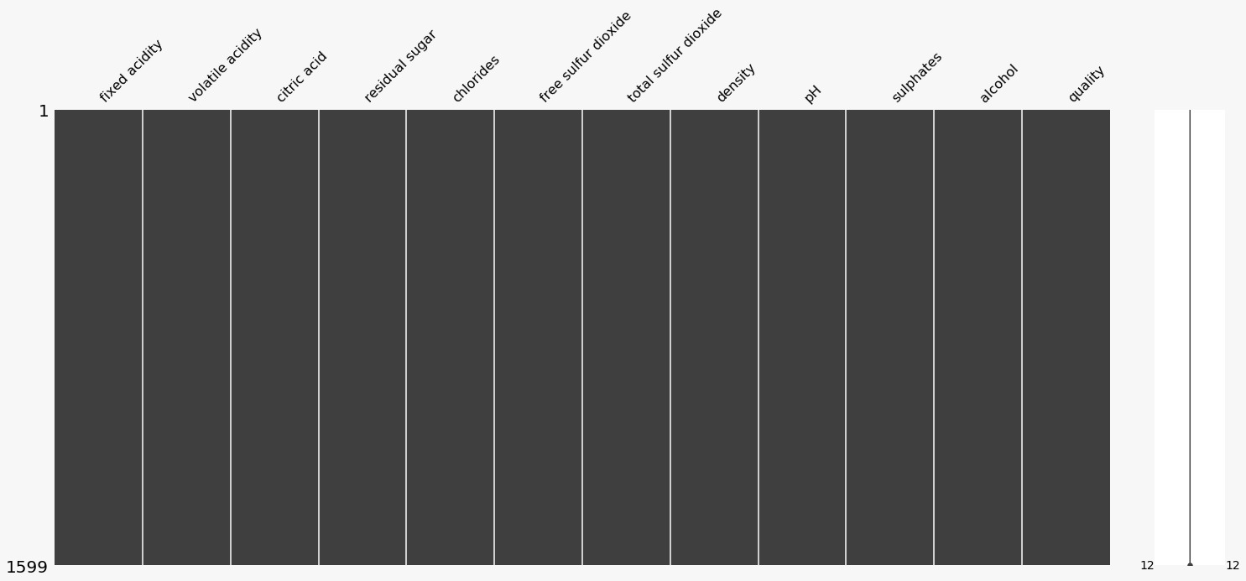
Bar-Chart Representation For Showing The NULL Values

Slide 14
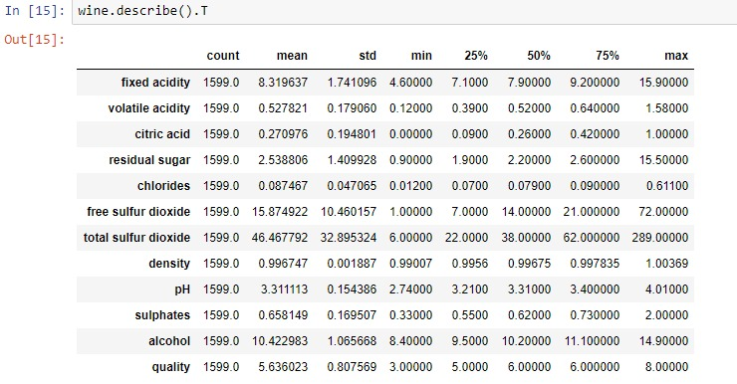
Stastical information for Dataset

Slide 15
Target Vector(Output column)
Our Target Vector is QUALITY. Nobody gave rating 0, 1, 2, 9, 10. This might be because most of the people randomly choose the rating 5 and 6 And surprisingly no body rated 9 and 10 means the wine quality might not be good in reality.

Slide 16
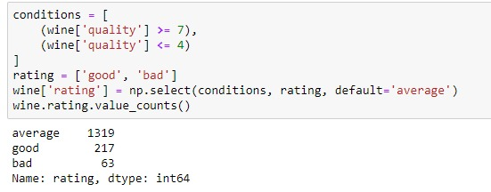
Converting numerical value to categorical value of Target Variables
We divide the Wine Quality into 3 Categories:
bad: 1-4
average: 5-6
good: 7-10

Slide 17
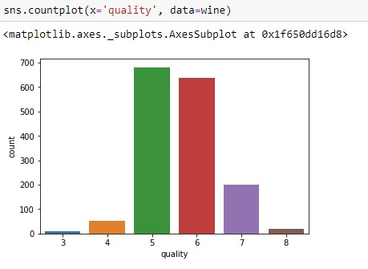
Target Vector (Output column)
This distribution shows the range for response variable (quality) is between 3 to 8.

Slide 18
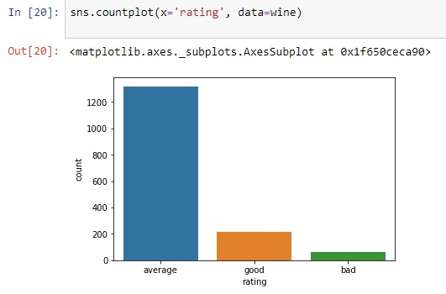
BAR-CHART REPRESENTATION

Slide 19
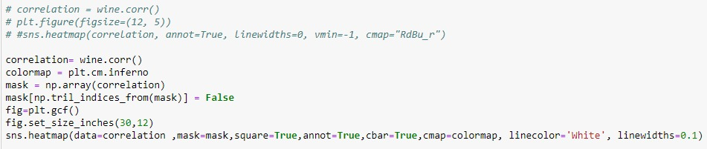
Correlation between features/variables

Slide 20
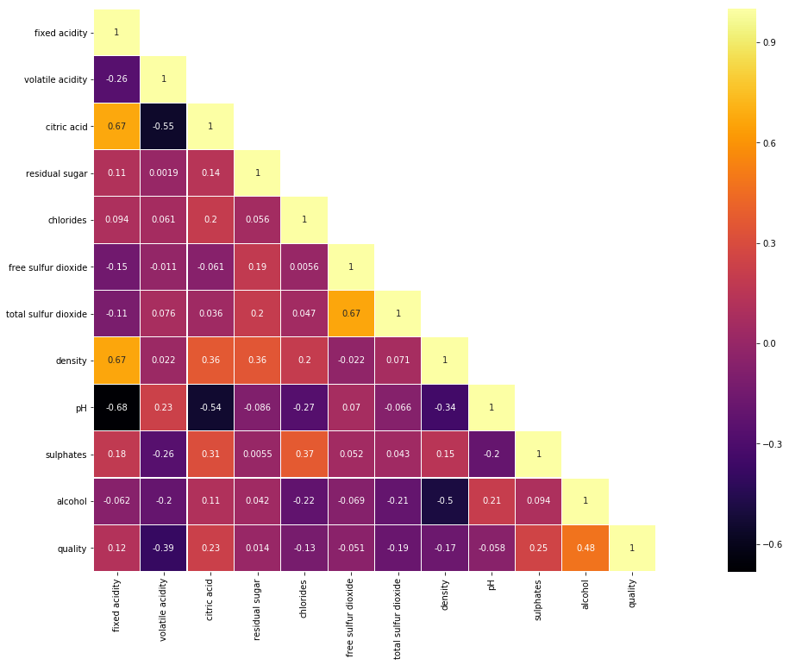

Slide 21
Correlation between features/variables
Most affecting Factors are:
• Alcohol
• Volatile acidity
• Sulphates
• Critic Acid
Least affecting Factors:
• Residual sugar
• Free Sulphur Dioxide
• Ph
Positive Correlated Factors:
• Alcohol
• Sulphates
• Citric acid
• Fixed acidity
(all the factors are in decreasing order Most to least)
Negative Correlated Factors:
• volatile acidity
• total sulfur dioxide
• density
• chlorides
(all the factors are in decreasing order Most to least)

Slide 22

Analysis for How Different Factors affect Wine-Quality

Slide 23
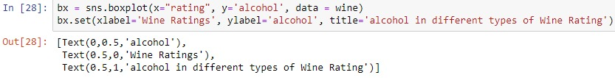
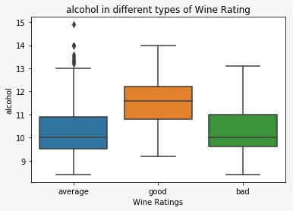
Analysis of alcohol percentage Vs wine quality

Slide 24
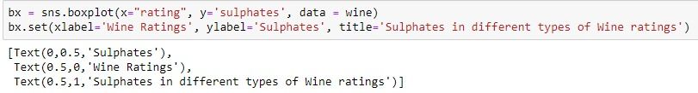
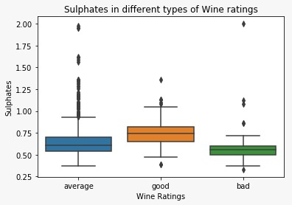
Analysis of sulphates Vs wine ratings:

Slide 25
Analysis of Citric Acid Vs wine ratings

Slide 26
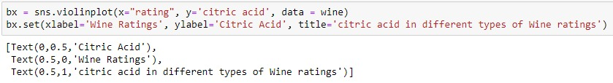
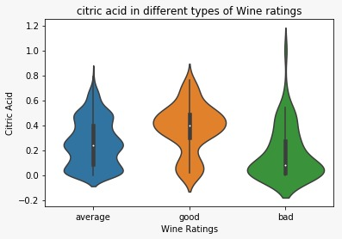
Analysis of Citric Acid Vs wine ratings

Slide 27
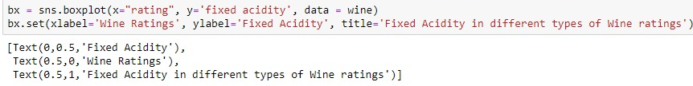
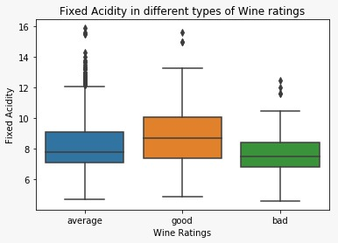
Analysis of fixed acidity & wine ratings

Slide 28
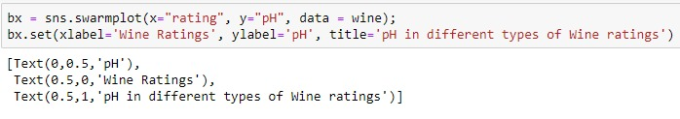
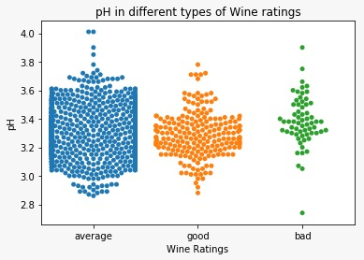
Analysis of pH Vs wine ratings

Slide 29
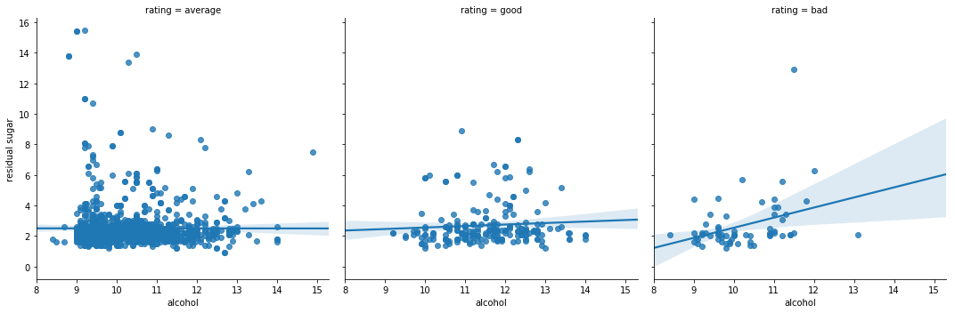
Linear Regression

Slide 30
Linear Regression
The linear regression plots above for different wine quality ratings (bad, average & good) shows the regression between alcohol and residual sugar content of the red wine.
We can observe from the trendline that, for good and average wine types the residual sugar content remains almost constant irrespective of alcohol content value. Whereas for bad quality wine, the residual sugar content increases gradually with the increase in alcohol content.
This analysis can help in manufacturing the good quality wine with continuous monitoring and controlling the alcohol and residual sugar content of the red wine.

Slide 31
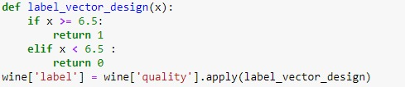
Apply Different Classifier on Dataset
For that we divide wine quality in label vector 1(good) and 0(bad)
1 (good) quality >= 6.5
0 (bad) quality < 6.5

Slide 32
Classification Techniques for Predicting Accuracy
K Nearest Neighbors
Logistic Regression
Random Forest Classifier
Decision Tree Classifier

Slide 33
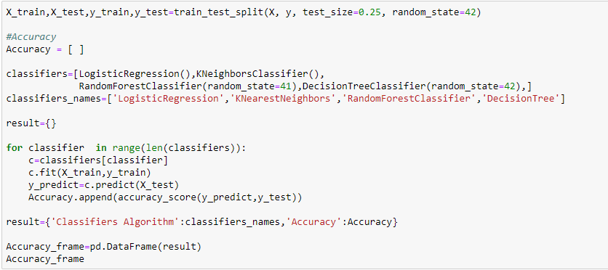
Accuracy (Without Normalization)

Slide 34
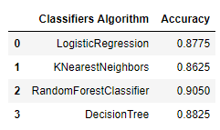
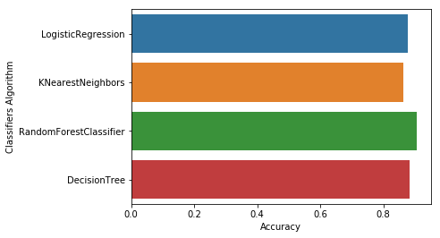
Accuracy (Without Normalization)

Slide 35
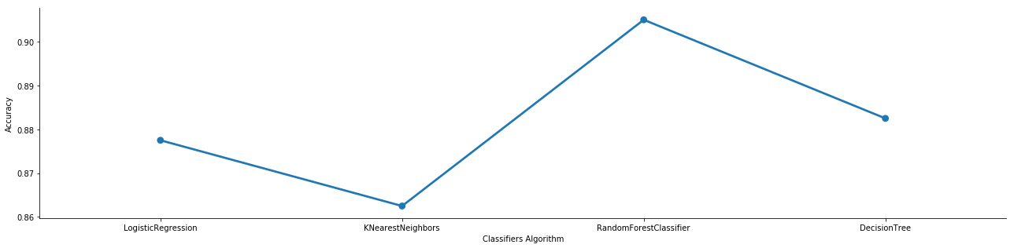
Accuracy (Without Normalization)

Slide 36
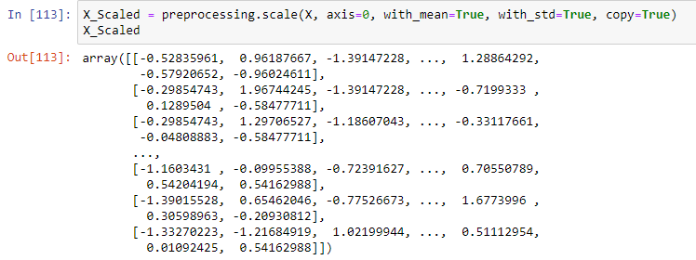
Accuracy (After Normalization)
Normalization of Feature Matrix

Slide 37
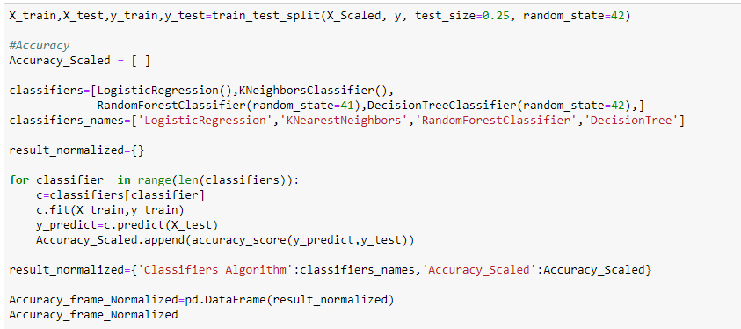
Accuracy (After Normalization)

Slide 38
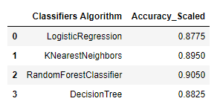
Accuracy (After Normalization)
We found that after normalization Accuracy remain same so, Data is Already Normalized

Slide 39
Responsibility Of Each Team Members
Kruti Shah :
Data Analysis For How Different Factor Affect Wine Quality
Find Accuracy : Random Forest, (BEFORE NORMALIZATION)
Decision Tree Algorithm, (BEFORE NORMALIZATION)
Presentation
Ravi Amin :
Correlation Between Features And Variables ,
Find Accuracy : Random Forest (AFTER NORMALIZATION)
Decision Tree (AFTER NORMALIZATION)
Documentation
Riddhiben Patel :
Data Analysis To Check For The Null/Missing Values
Statistical information for Dataset
Learn about Target Vector
Find Accuracy : Logistic Regression, (BEFORE NORMALIZATION)

Slide 40
Responsibility Of Each Team Members
Rutviben Patel :
Correlation Between Features And Variables,
Find Accuracy : KNN (AFTER NORMALIZATION)
LOGISTIC (AFTER NORMALIZATION)
Presentation
Smitkumar Kaushikkumar Patel:
Converting numerical value to categorical value of Target Variables
Data Analysis For How Different Factor Affect Wine Quality ,
Correlation Analysis
Find Accuracy : LINEAR REGRESSION ,
KNN (BEFORE NORMALIZATION)
Documentation

Slide 41


